Slide 1
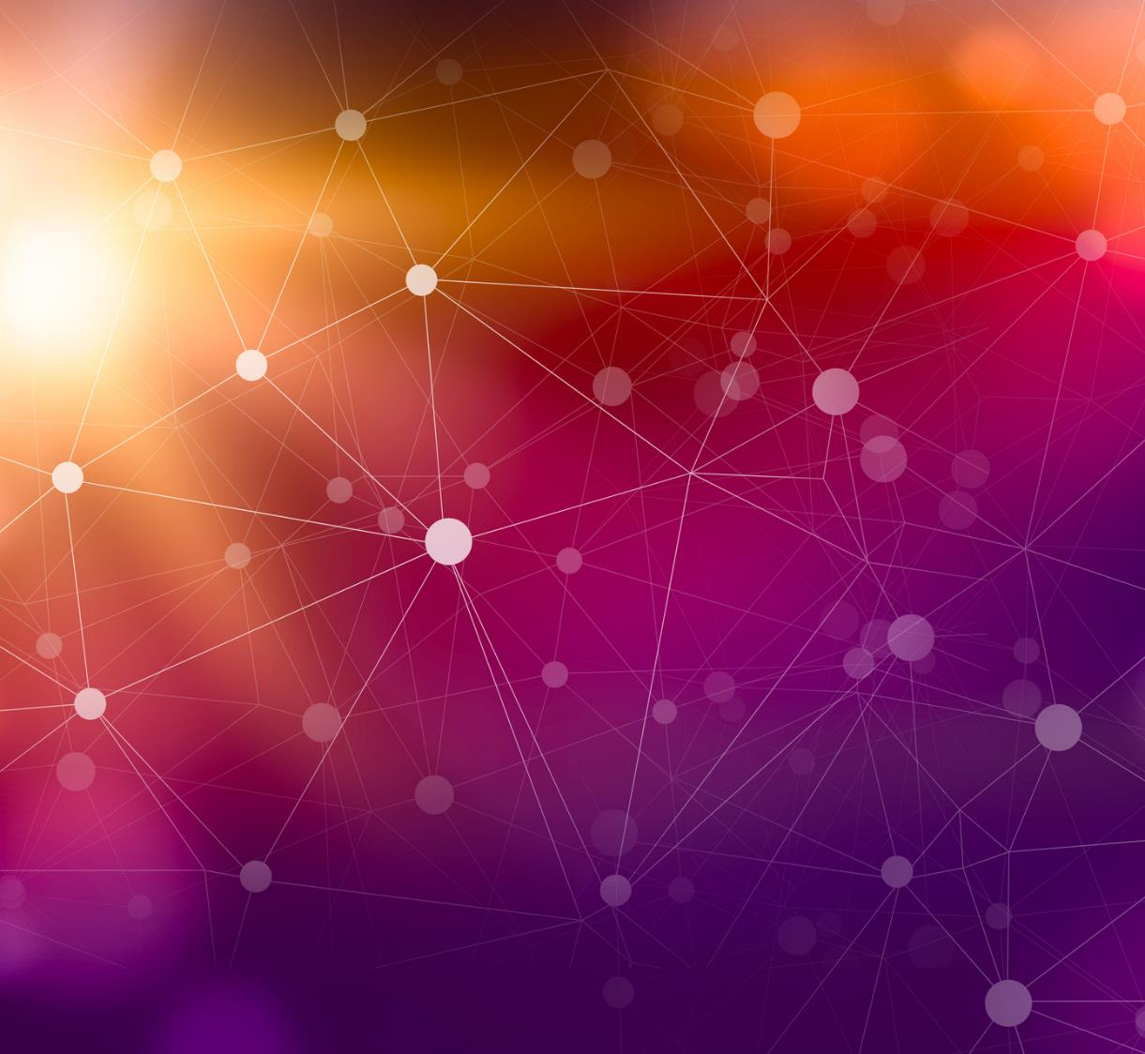
Kidney Stone Detection
S. M. Abbas Zaidi

Slide 2
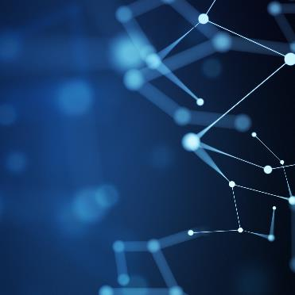
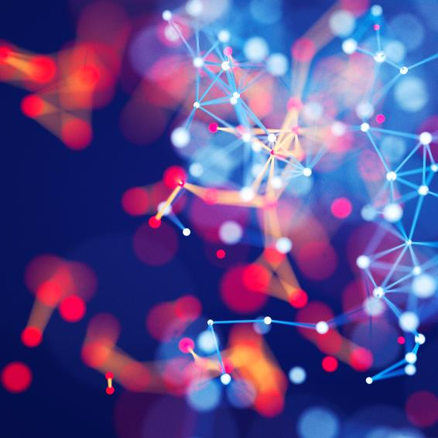

Agenda
Collection of Data Set
CNN
GUI

Slide 3
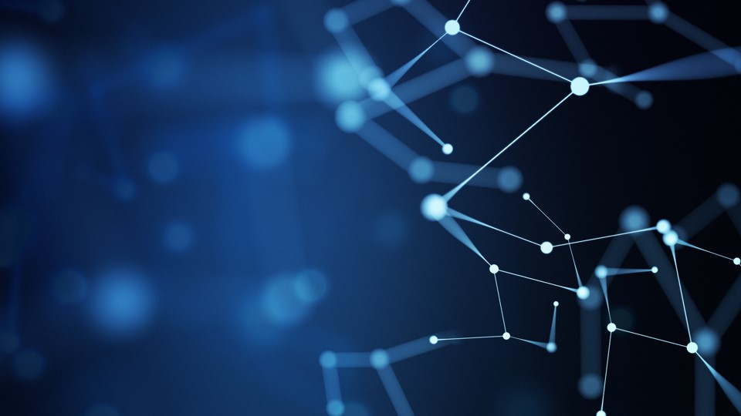
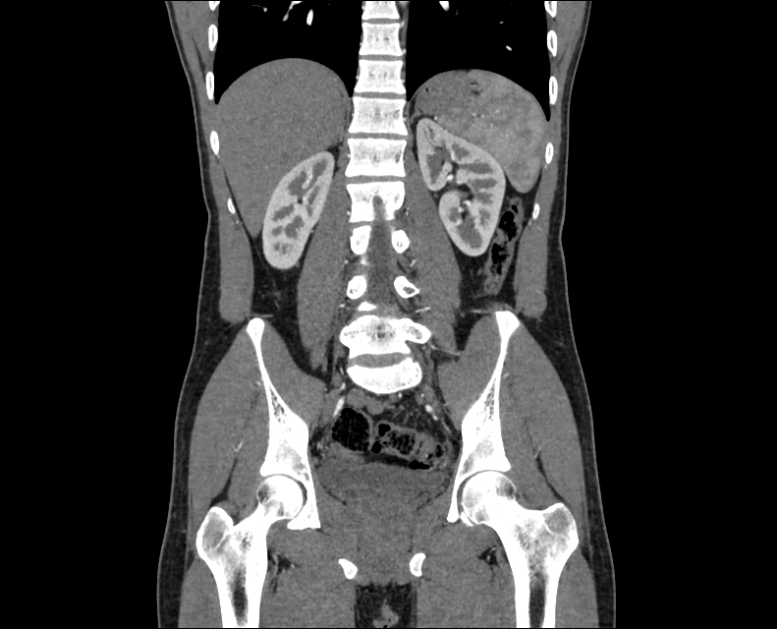
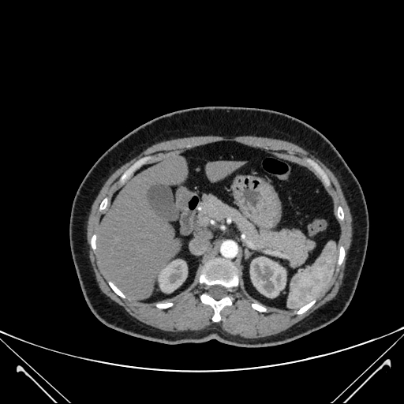
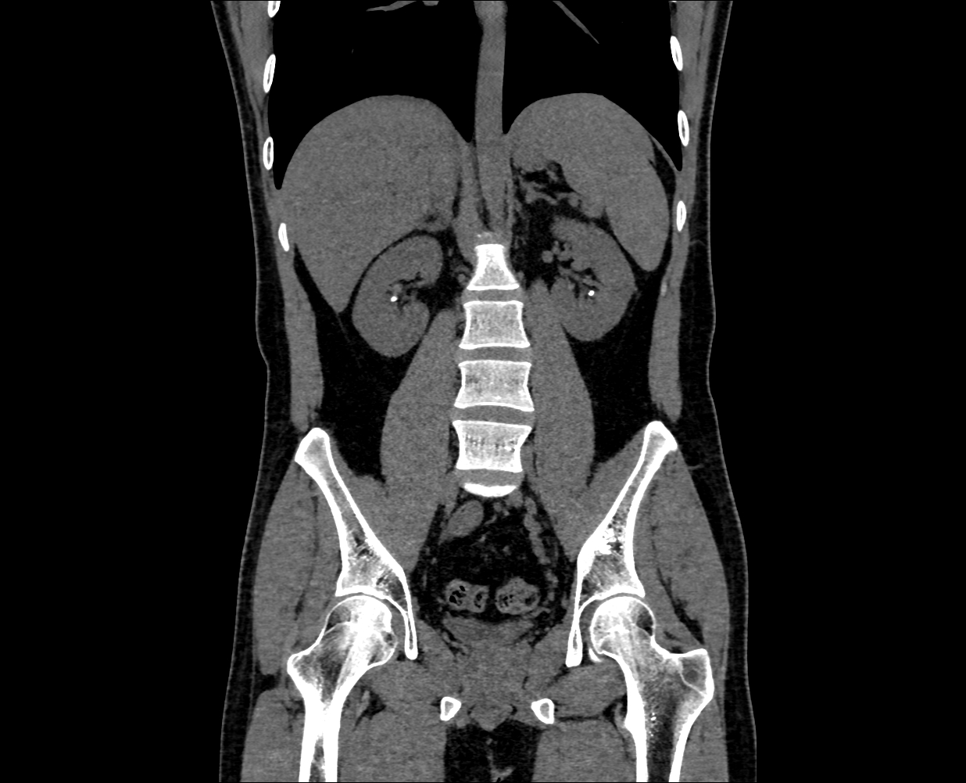
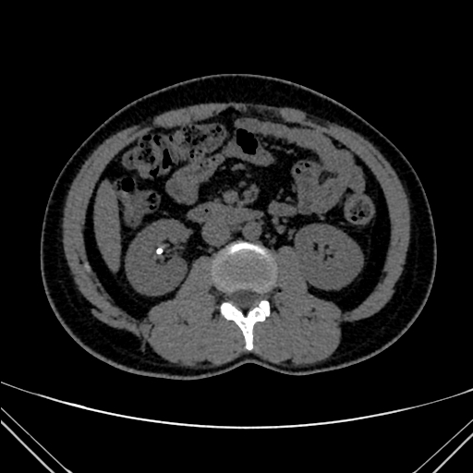
Dataset Collection
Normal
Our dataset consist of CT images with two classes Normal and Stone
Source: Kaggle.com
Stone

Slide 4
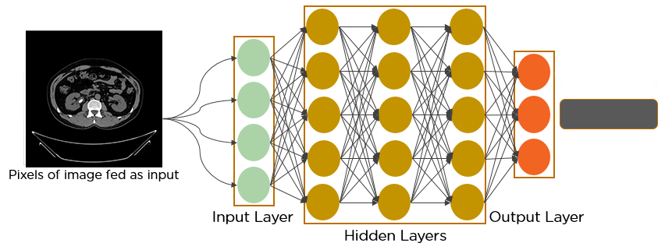
Convolutional Neural Network
Classification

Slide 5
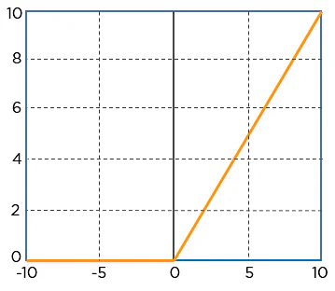
Layers in Convolutional Neural Network
CNN has multiple hidden layers which helps in extracting features and classification of images:
Convolutional Layer
Several Filters
Extract convolutional Features
ReLU Layer (Rectified Linear Unit)
  Element Wise Operation
Maps negative pixels to zero

Slide 6
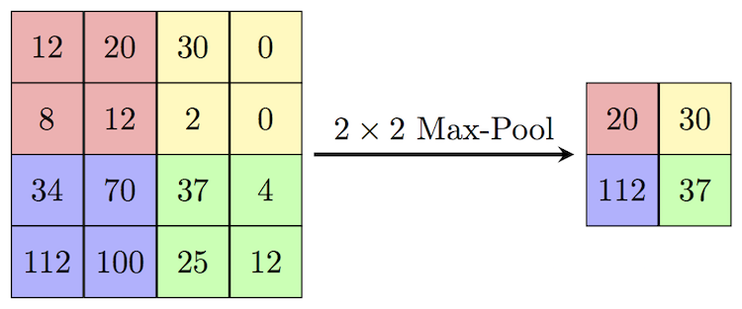
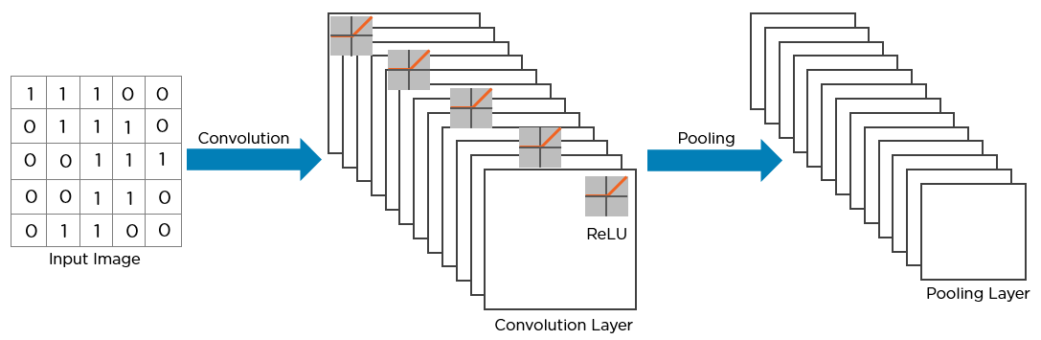
Layers in Convolutional Neural Network
Pooling Layer
Convolutional Layer also records the precise location of features
Down-Sampling
The Picture So far

Slide 7
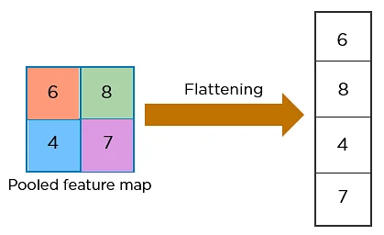
Layers in Convolutional Neural Network
Flattening Layer
Converts 2D array to 1D feature Vector
Dense Layer
Classification based on output of convolution layers
It requires 1D that’s why flatten layer is used

Slide 8
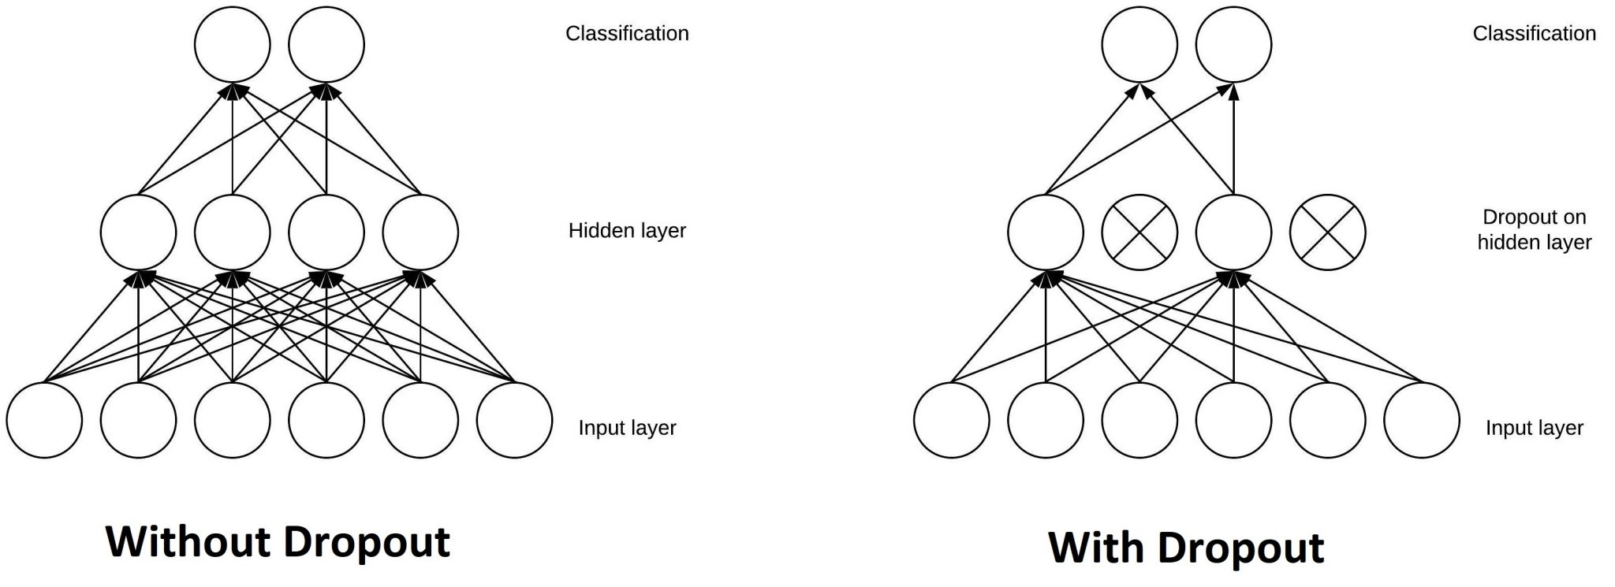
Layers in Convolutional Neural Network
Dropout Layer
Nullifies contribution of some neurons randomly
To Avoid overfitting

Slide 9
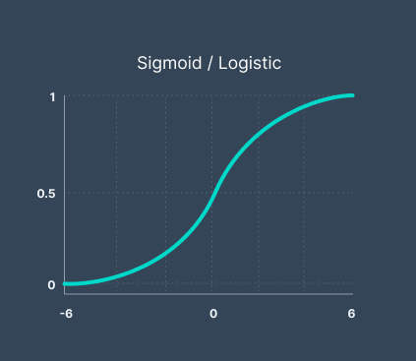
Layers in Convolutional Neural Network
Sigmoid Layer
Maps values in the range of 0 and 1
As our classification is binary(Normal and Stone)

Slide 10
from keras.models import Sequential
from keras.layers import Dense, Conv2D, MaxPooling2D, Dropout, Flatten, Activation
model = Sequential()
#Adding convolutional layers
model.add(Conv2D(32, (3, 3), input_shape=(150, 150, 3)))
model.add(Activation('relu'))
model.add(MaxPooling2D(pool_size=(2, 2)))
#Adding a second convolutional layer
model.add(Conv2D(32, (3, 3)))
model.add(Activation('relu'))
model.add(MaxPooling2D(pool_size=(2, 2)))
model.add(Flatten()) # this converts our feature maps to 1D feature vectors
model.add(Dense(64)) #To combine neurons
model.add(Activation('relu'))
model.add(Dropout(0.5)) #To avoid overfitting randomly drop some neurons
model.add(Dense(1))
model.add(Activation('sigmoid’))

Slide 11
Thank You

